Slide 1
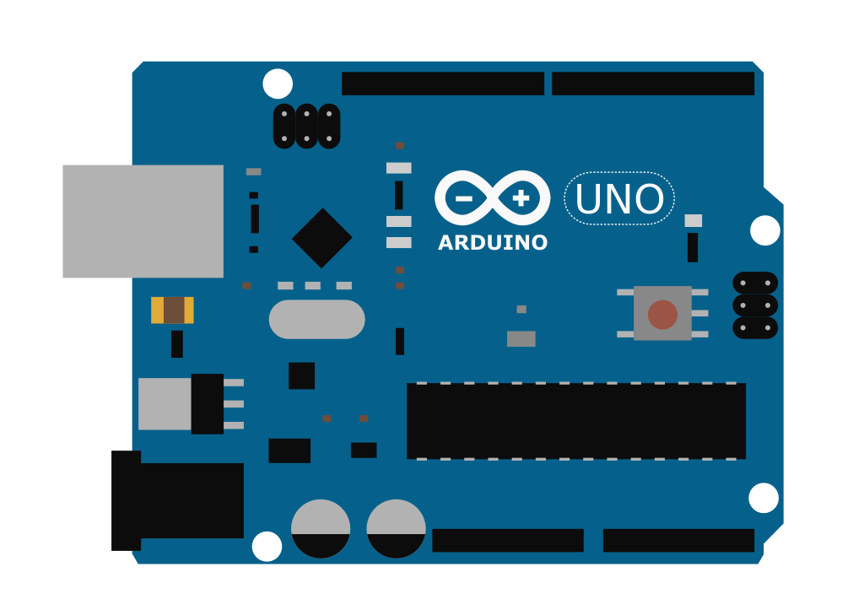
⠀⠀Arduino Workshop⠀⠀
⠀⠀Hosted by IEEE UC San Diego⠀
Antony Nguyen⠀and⠀Jianing Zhang⠀⠀⠀
Notes:
Keshav

Slide 2


Who are we?
Johnny Zhang
Antony Nguyen

Slide 3





Introduction
Open Source
Well Documented
Easy / User friendly
Both hardware &
software
Notes:
Keshav

Slide 4
Install IDE
Circuit Building
Servos / Sensors
Arduino Syntax
Putting it together
Basic Arduino syntax
Basic circuit building
Other Applications:
Servo motors
Infrared sensors
Notes:
Keshav

Slide 5
Installation
1
Go to https://www.arduino.cc
2
Software → Downloads
3
Download latest version for your OS
Notes:
Remind ppl to install IDE via announcements
Keshav

Slide 6
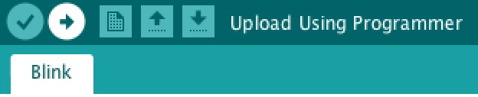
Set-up Check!
Open IDE. Go to File → Examples → 0.1. Basics → Blink
Tools: Make sure correct board + port are selected (Arduino Uno)
Upload: LED onboard should be blinking
Notes:
Keshav

Slide 7
Sketch
Requirements
1
void setup() {
}
void loop() {
}
*Even if you don’t want these functions to run anything, they still need to be declared
2
Notes:
Antony

Slide 8
Blink Breakdown!
pinMode(PIN,TYPE)
PIN is the pin number you are setting
TYPE is whether that pin is INPUT or OUTPUT
digitalWrite(PIN,TYPE)
PIN is the pin number you are setting TYPE is whether that pin is HIGH or LOW
delay(time)
Stops the program for time (in milliseconds)
Notes:
Antony

Slide 9
What is a circuit?
A circuit is very similar to a tube flowing with water. Voltage is the gravitational energy that propels water to move from a higher position to a lower one.
Electricity always flows from a higher voltage to a lower voltage. We use ground as our low voltage point
Open Circuit: A poorly connected circuit where two ends aren’t fully connected
Short Circuit: Too much current which damages components and may cause a fire. If this happens turn off everything immediately!
Always make sure you have a clean and safe environment before building any circuit
Notes:
Johnny

Slide 10
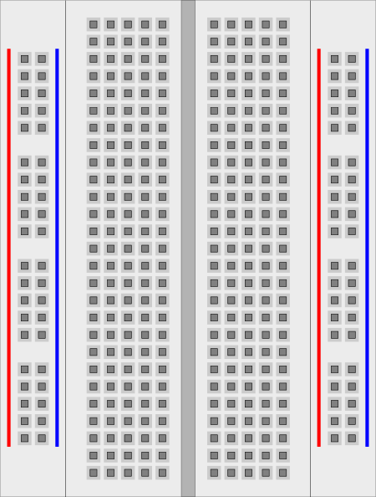
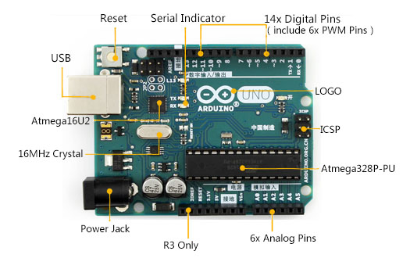
Arduino Overview and Breadboard Usage
Two major categories:
Vertical section-holes connected from top to bottom
Horizontal section-holes in row connected through
Notes:
Johnny, Ground is in Chinese

Slide 11
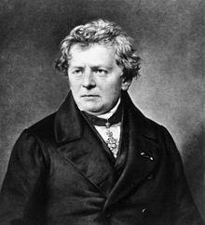
Ohm’s Law
The current through a conductor between two points is directly proportional to the voltage across the two points.
V
I =
R
We will be using this equation to check how much resistance is needed to maintain the recommended current flow through the various components of the circuit. Keep in mind that all Arduinos are 5V.
Notes:
Johnny

Slide 12
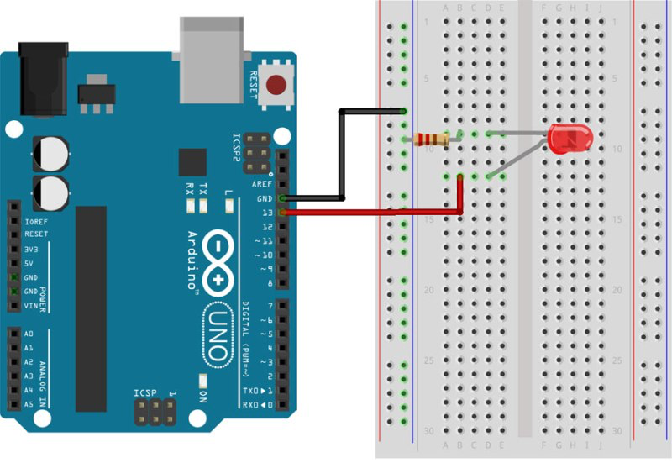
Circuit Diagram - LED is connected to Pin 12
Notes:
Johnny

Slide 13

Let’s add a button!
Ideas
Make an SOS tool using morse code
Create interesting patterns with multiple LED’s
Combine LED’s with other components like IR sensors or motors

Slide 14
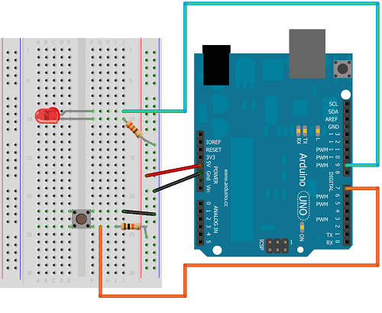
Circuit Diagram
Make an SOS tool using morse code
Create interesting patterns with multiple LED’s
Combine LED’s with other components like IR sensors or motors

Slide 15
Code overview
AT TOP
const int buttonPin = 7;
const int ledPin = 9;
int buttonState = 0;
IN SETUP()
pinMode(ledPin, OUTPUT);
pinMode(buttonPin, INPUT);

Slide 16
Enter the if statement!
IN LOOP
buttonState = digitalRead(buttonPin);
if(buttonState == HIGH) {
// Turn the LED on
}
else {
// Turn the LED off
}

Slide 17
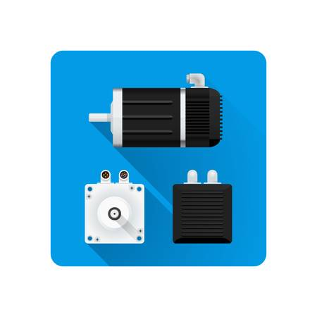
I wanna move!
Make an SOS tool using morse code
Create interesting patterns with multiple LED’s
Combine LED’s with other components like IR sensors or motors

Slide 18
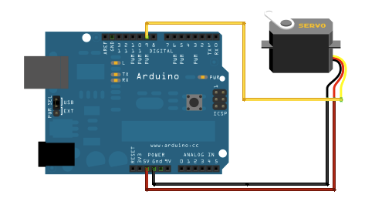
Servos
Servomotors are actuators that allow for precise control of angular / linear position
Go to File-->Examples-->Servo-->Sweep to test it out.
Notes:
Antony

Slide 19
Code overview
AT TOP
Servo servo1; // Declares a servo object
int servoPin = //TODO - Fill with your own servo pin
IN SETUP()
servo1.attach(servoPin) // Attaches the Servo object to a pin
servo1.write(90) // Rotates the Servo to 90 degrees

Slide 20
For loop?
IN LOOP
for(int i = 0; i <= 180; i++) { // Start, End, Increment
servo.write(i); // Writes to an angle
delay(15) // Delay by 15 milliseconds
}

Slide 21


Slide 22
Serial
Used for communication between Arduino and a computer
Serial.begin(9600); :Sets the data rate in bits per second
Serial.print() : Print information to serial monitor
Serial.read() : Read information from serial monitor
Serial.available(): Checks if bits are available for reading
Notes:
Antony

Slide 23
Code overview
IN SETUP()
Serial.begin(9600);
IN LOOP()
Serial.print(“Hello World”);
delay(1000);

Slide 24
AT TOP
char val;
IN LOOP()
if(Serial.available()) {
val = Serial.read();
}
if(val == ‘a’) {
Serial.print(“Hello world”);
delay(1000);
}

Slide 25

Notes:
Antony

Slide 26

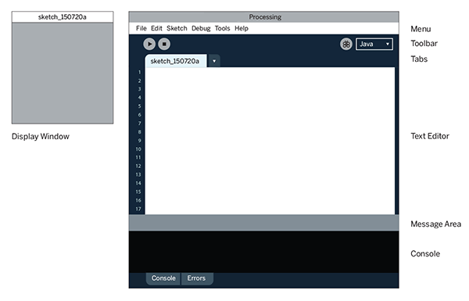
Processing
A predecessor to Arduino so we can communicate between them using Serial
Notes:
Keshav

Slide 27
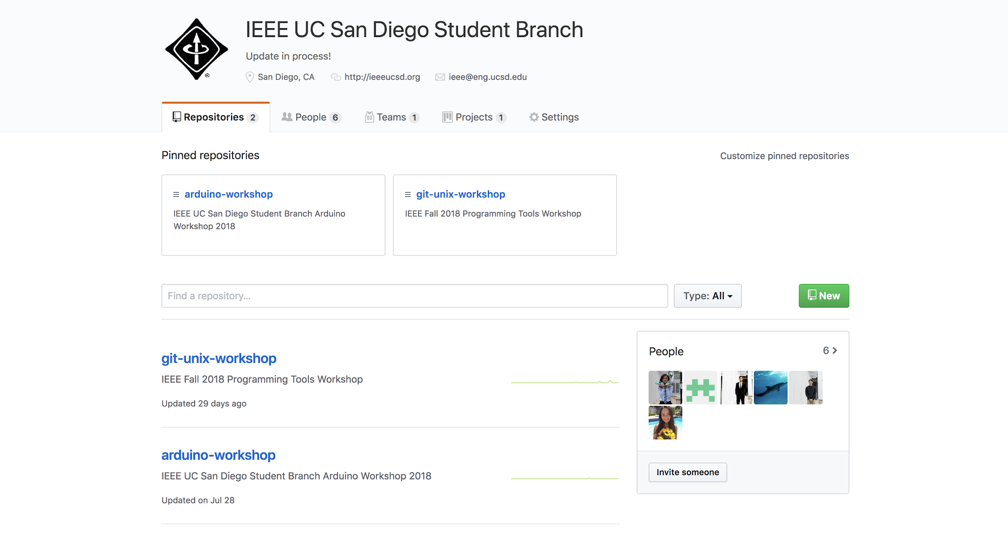
https://github.com/ucsdieee

Slide 28

Let’s get started!

Slide 29
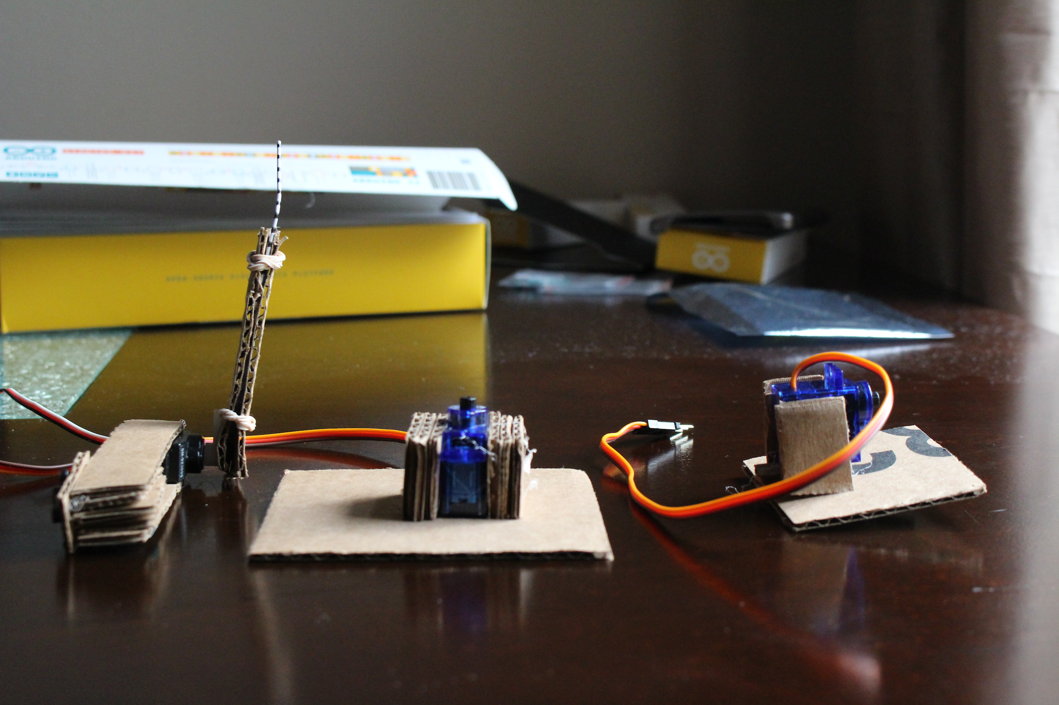
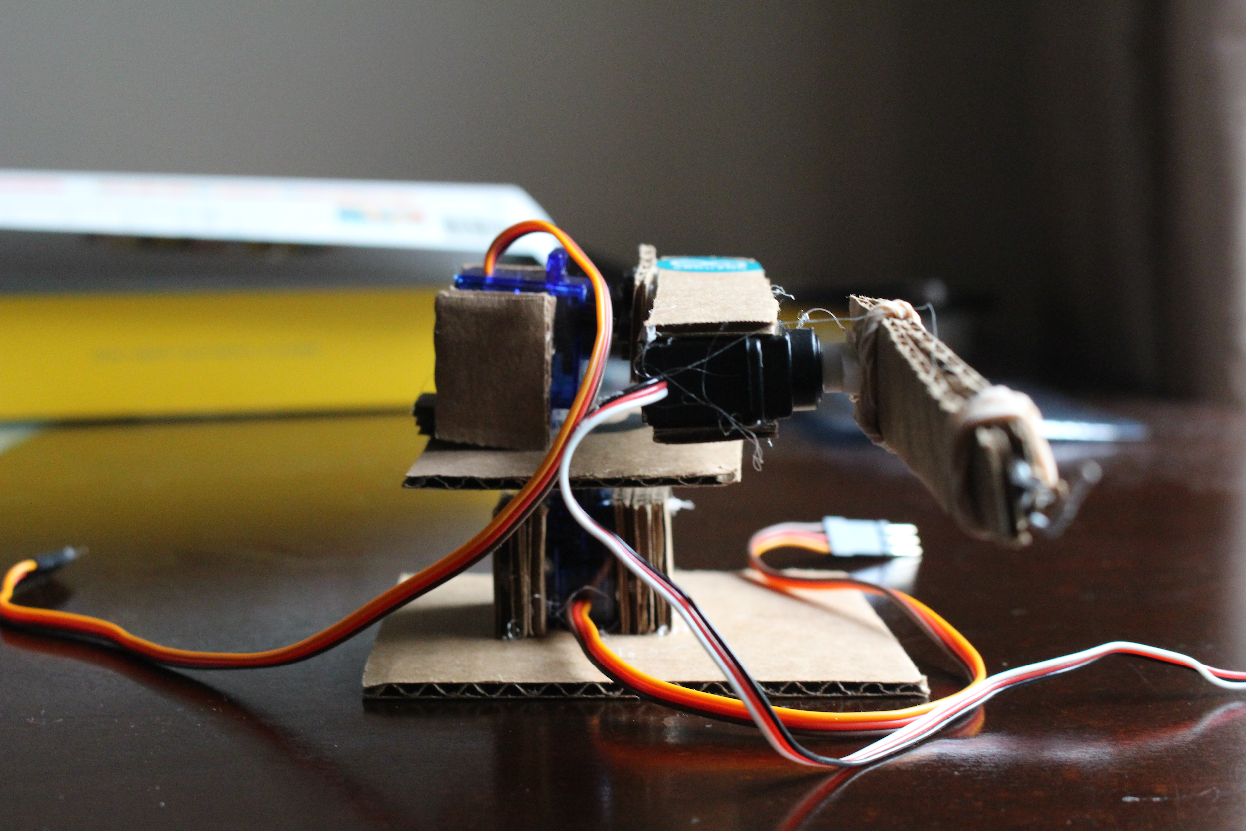

Slide 30
Thank you!
IEEE Workshop Schedule: https://tinyurl.com/IEEEWorkshopSchedule

